Slide 1

EEG-Based ADHD Detection Using a Multi-Model Deep Learning
ADHD classification from EEG signals is challenging because EEG contains complex temporal, spatial and frequency-domain information.
GROUP ID: 1605
Team Members:
1.S. R. Karthikeya
2.Keerthi
3.Amuktha
4.Ambika
5.Grithika
Mentor: Dr.M.Deepika

Slide 2
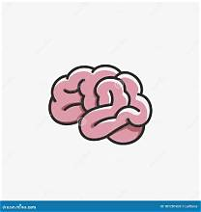
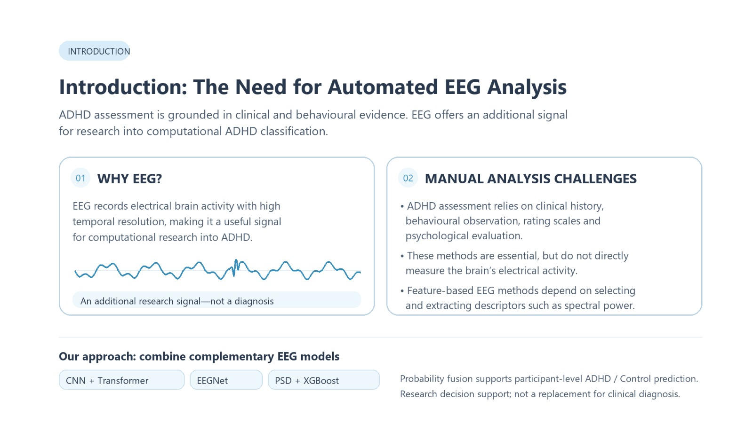
INTRODUCTION

Slide 3
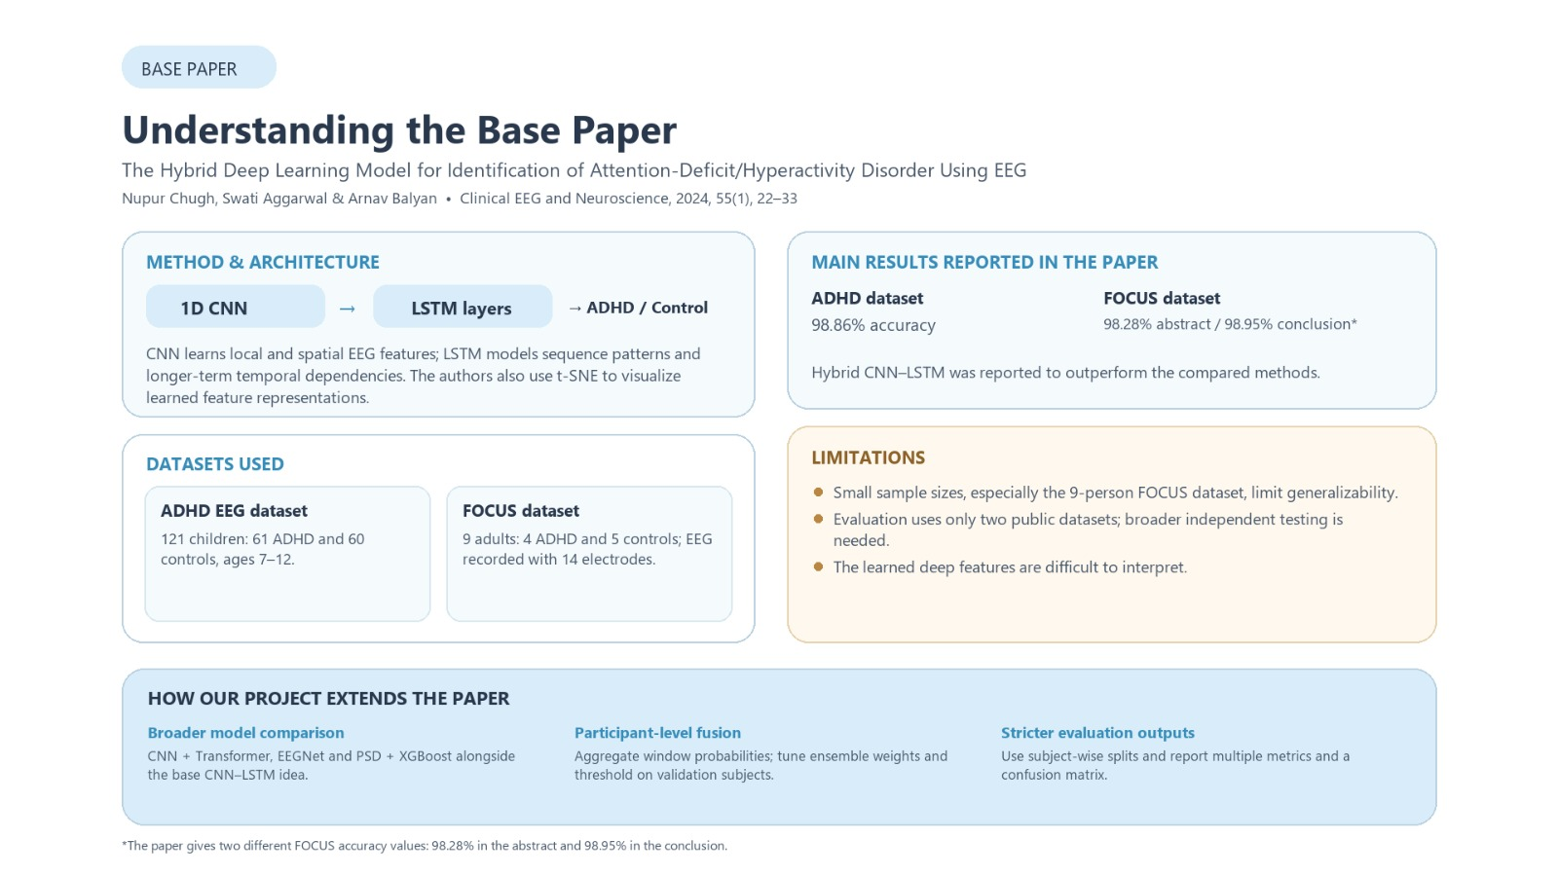
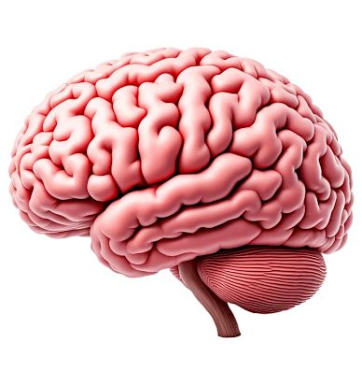

Slide 4
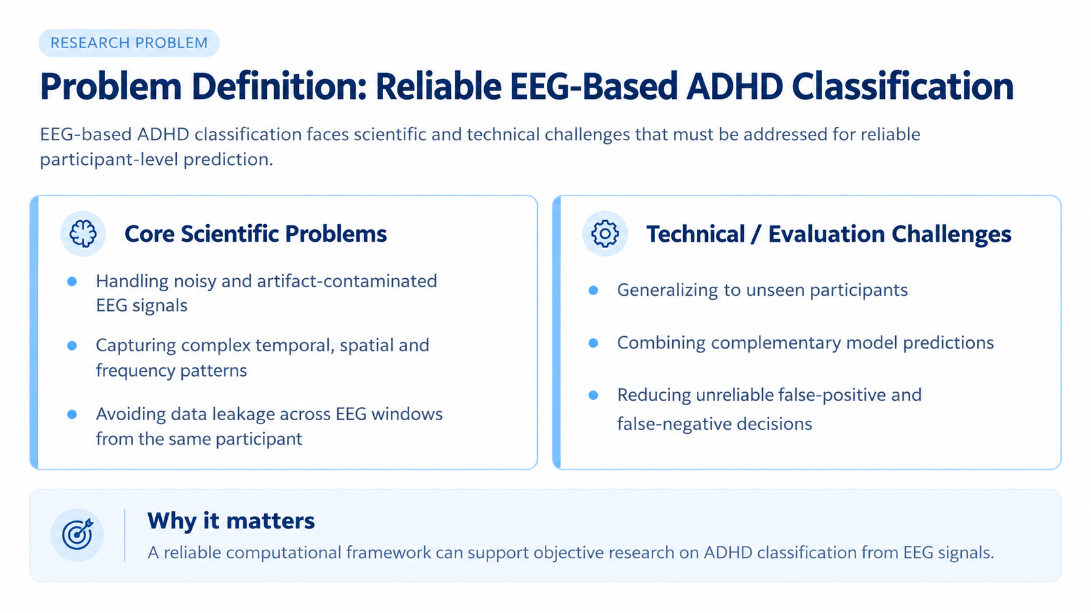
Problem Definition

Slide 5
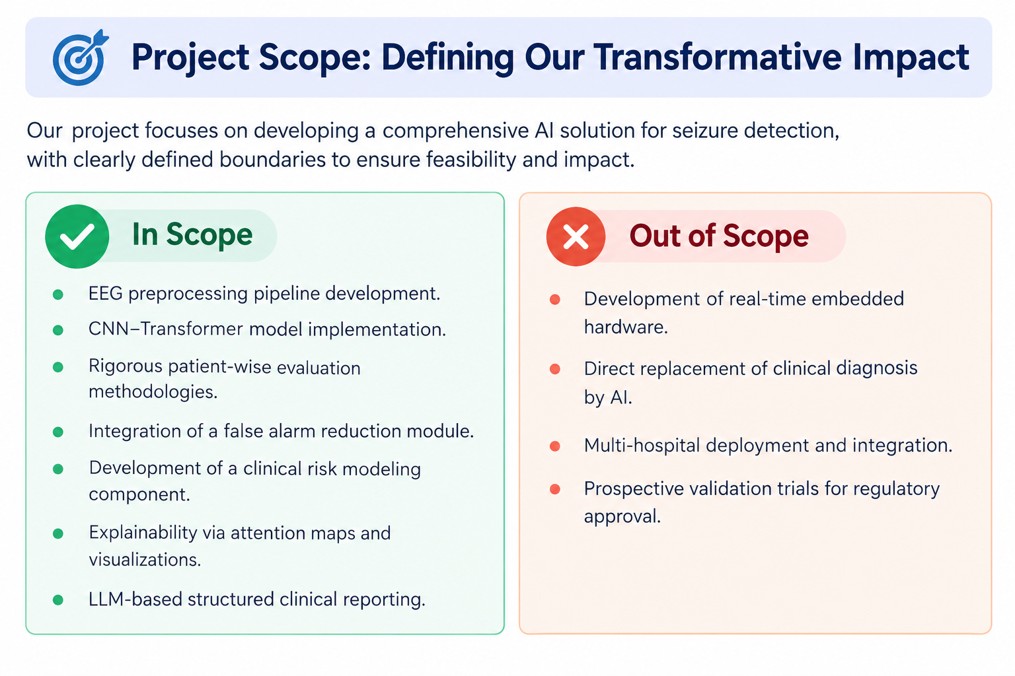
PROJECT SCOPE

Slide 6
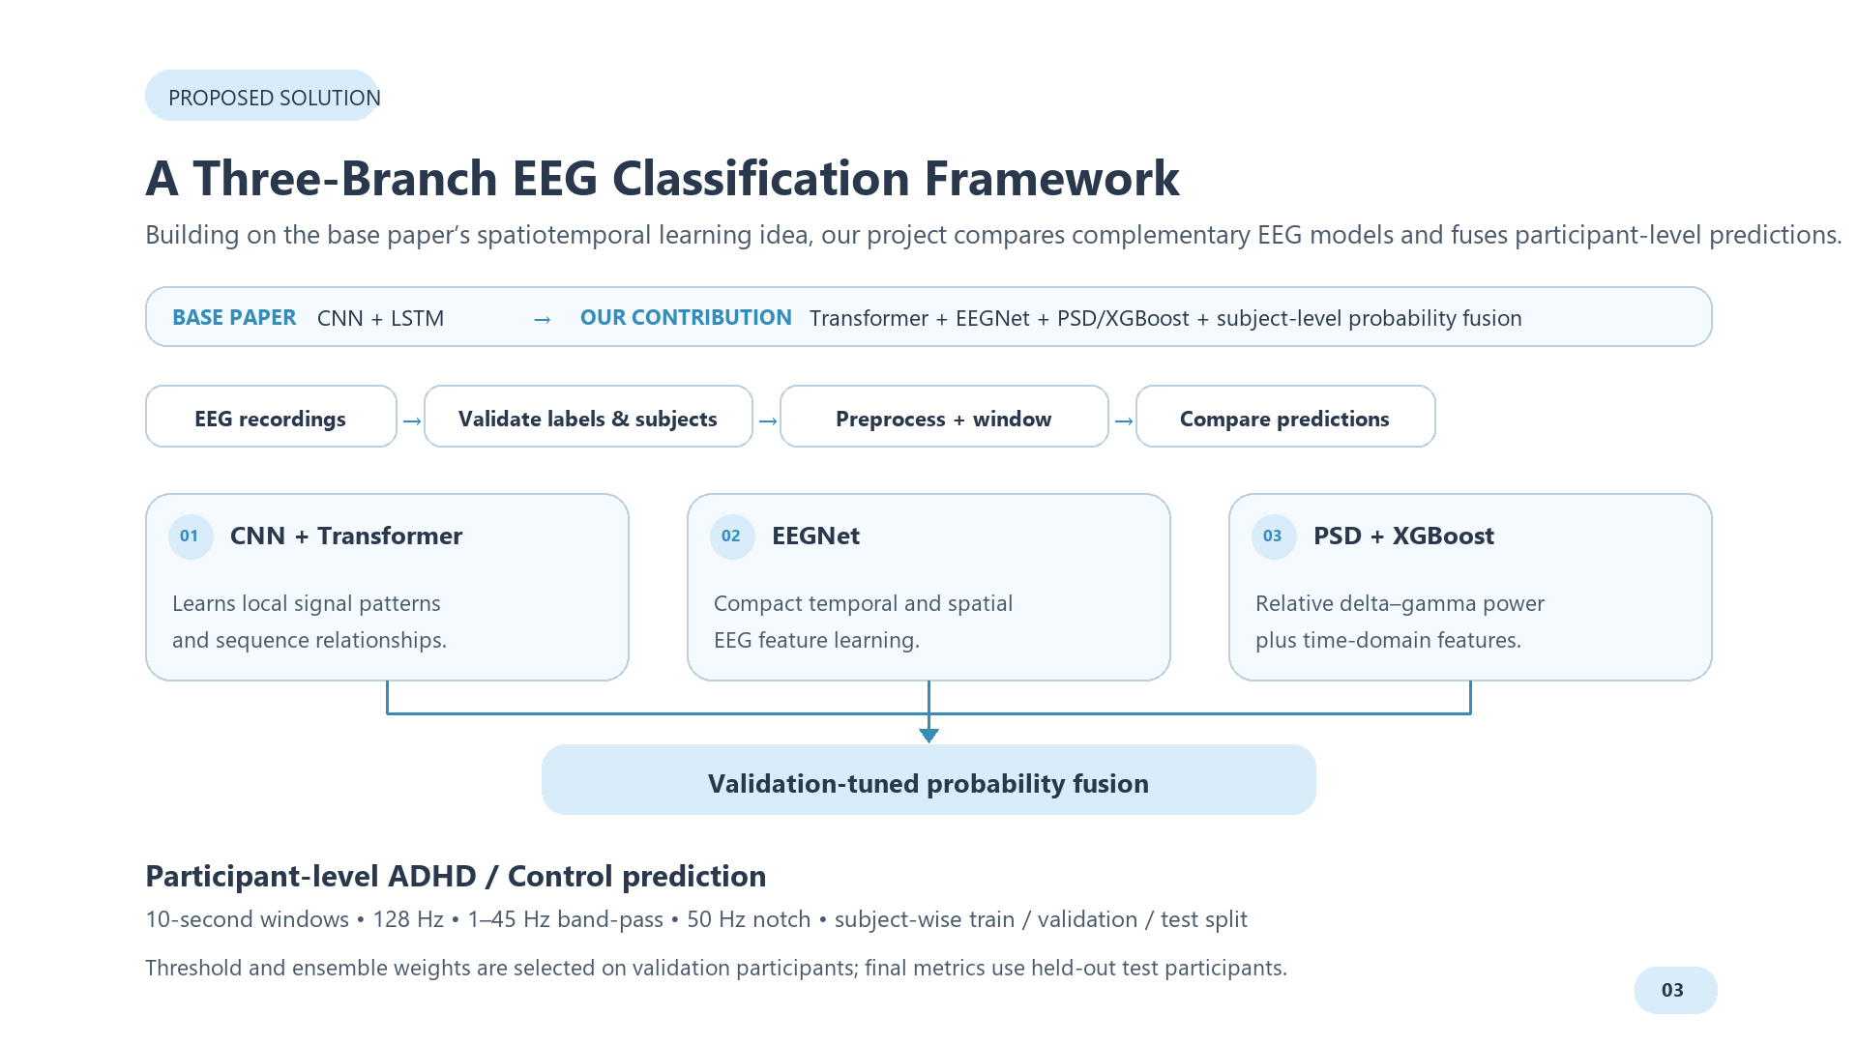
PROPOSED SOLUTION

Slide 7
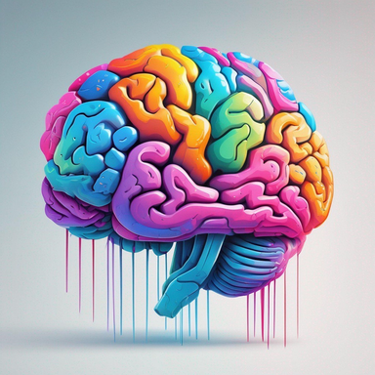
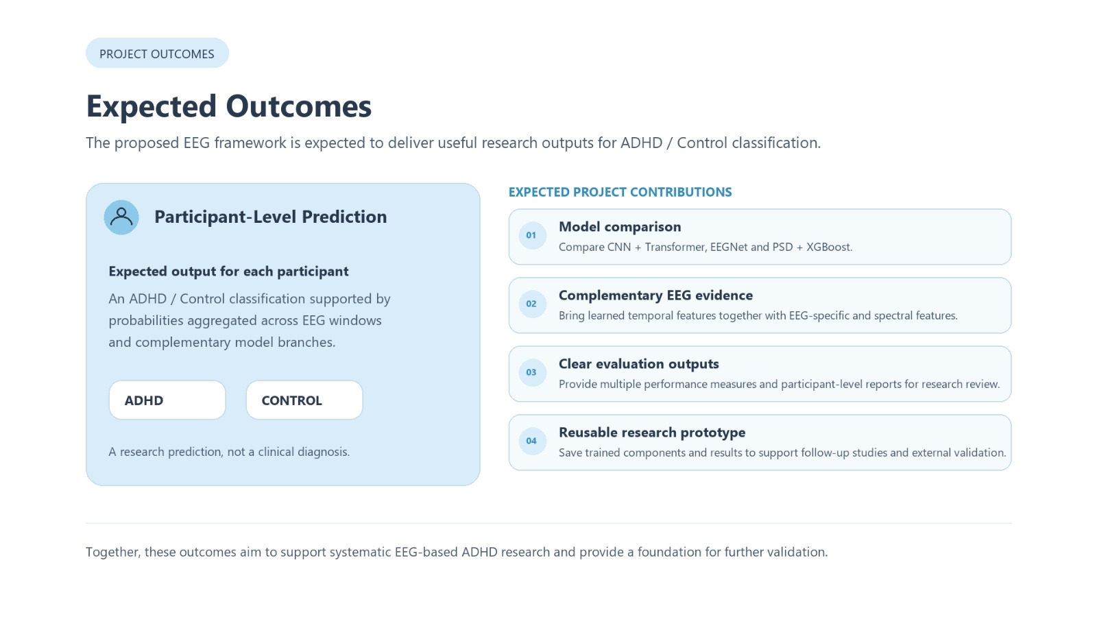
  Clinical Manifestations

Slide 8
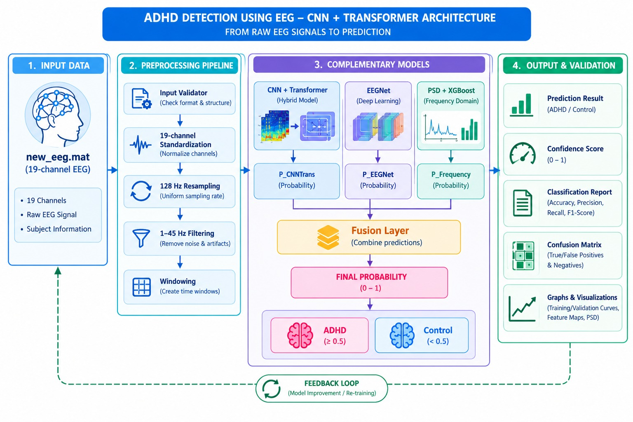
ARCHITECTURE DIAGRAM

Slide 9
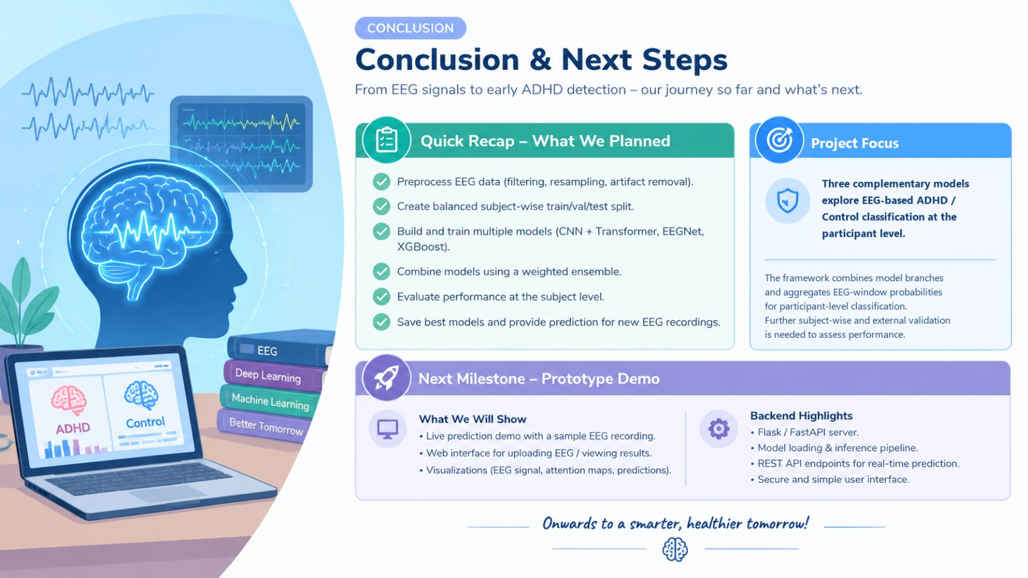

Slide 10
Thank You

